Slide 1

EXCEL STATISTICS FOR BUSINESS ANALYTICS

Slide 2

George Mount
Data Analyst & Educator at Stringfest Analytics
George works as an independent analyst and data analytics educator with the goal to help clients manage their data so they think more creatively. He serves as a technical expert and lead curriculum developer for Thinkful’s data analytics program and is the instructor of the DataCamp course “Survey and Measure Development in R.”
George blogs about data, innovation, and career development at georgejmount.com. He holds a master’s degree in information systems with a certificate of achievement in quantitative methods from Case Western Reserve University

Slide 3

OBJECTIVES FOR TODAY
Explore a dataset for research questions
Check assumptions and build hypotheses
Test formally for a difference in means between two groups
Make compelling business recommendations using inferential statistics
Excel Statistics for Business Analytics

Slide 4

WHY WOULD WE DO THIS IN EXCEL?
“You get to look at the data every step of the way, building confidence while learning the tricks of the trade.”
-- John Foreman
Excel Statistics for Business Analytics

Slide 5
1. EXPLORATORY DATA ANALYSIS IN EXCEL

Slide 6


What the hey is EDA?
Preliminary understanding of variables
Classify them
Summarize them
Visualize them
Check assumptions before using them
YOU
YOUR DATA

Slide 7
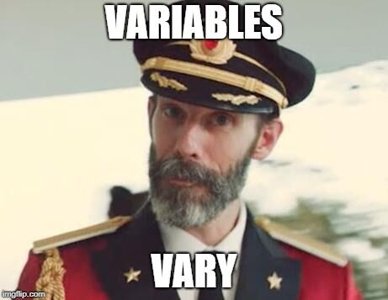
What is a variable?
Classical statistics: at least a 90%/10% split

Slide 8

VARIABLE TYPES AS RECIPE INGREDIENTS

Slide 9
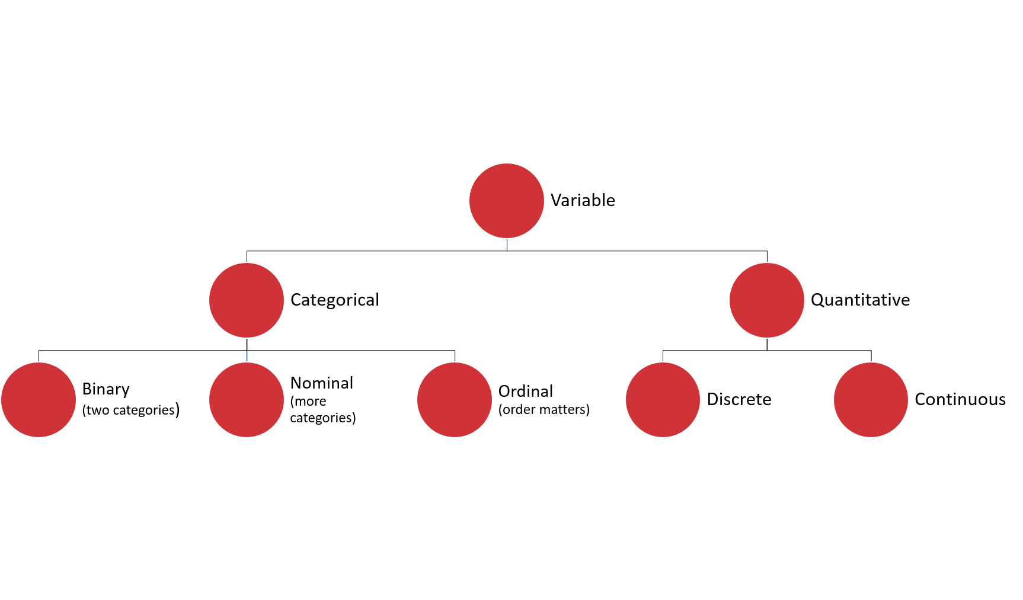

Slide 10
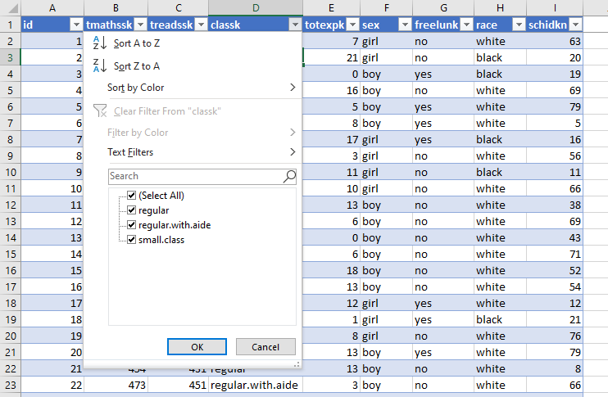
DRILLS
Dataset: wages.xlsx
What type is each variable?
(Don’t be afraid to poke at the data!)
Variable | Description | Type?
tmathssk | Total math scaled score
treadssk | Total reading scaled score
classk | Type of class
totexpk | Years of total teaching experience
sex | Sex
freelunk | Qualified for free lunch?
race | Race
schidkn | School indicator

Slide 11
DRILLS
Dataset: wages.xlsx
What type is each variable?
(Don’t be afraid to poke at the data!)
Variable | Description | Type?
tmathssk | Total math scaled score | Continuous
treadssk | Total reading scaled score | Continuous
classk | Type of class | Nominal
totexpk | Years of total teaching experience | Discrete
sex | Sex | Binary
freelunk | Qualified for free lunch? | Binary
race | Race | Nominal
schidkn | School indicator | Nominal

Slide 12

WHO KNOWS?
VARIABLE TYPES ARE CONTEXTUAL
IT’S NEBULOSE…

Slide 13
What the hey is EDA?
Preliminary understanding of variables
Classify them
Summarize them
Frequencies
Descriptive statistics
Visualize them
Check assumptions before using them
YOU
YOUR DATA

Slide 14
Summarizing a variable: frequencies
Used for categorical variables
How many of each value do we have? (Counts)
Use PivotTables
Demo: wages.xlsx

Slide 15
Summarizing a variable: descriptive statistics
Descriptive statistics
Used for continuous variables
Central tendency: what value is the variable centered around?
Mean: “average”
Median: “middle”
Mode: “most common”

Slide 16
DRILL
You are consulting for a non-profit on fundraising strategies
Donation data is shown to the right
Which measure of central tendency (mean/median/mode) should be tracked?
Variable
10
10
20
30
100

Slide 17
DRILL
You are consulting for a non-profit on fundraising strategies
Donation data is shown to the right
Which measure of central tendency (mean/median/mode) should be tracked?
No one statistic rules them all
Variable
$10
$10
$20
$30
$100
Statistic | Value
Mean | $34
Median | $20
Mode | $10

Slide 18
Summarizing a variable: descriptive statistics
Variability: how spread is the variable from the center?
Range: What are the min/max?
Variance: Relative to the mean, how far away does the data fall?
Standard deviation: Square root of the variance

Slide 19
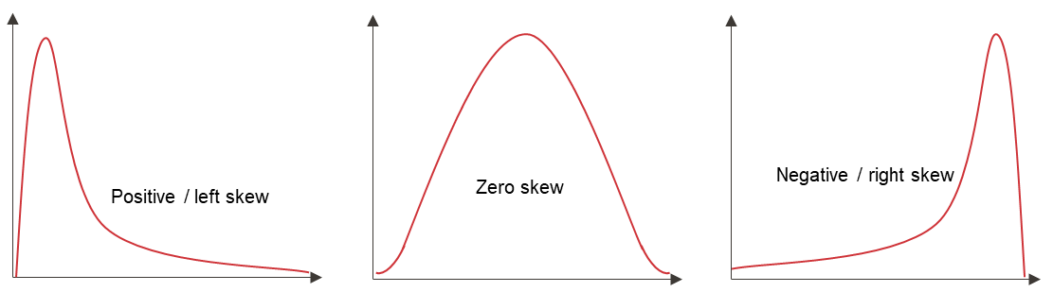
Summarizing a variable: descriptive statistics
Distribution: How is the data distributed?
Skewness: How lopsided is the data?

Slide 20
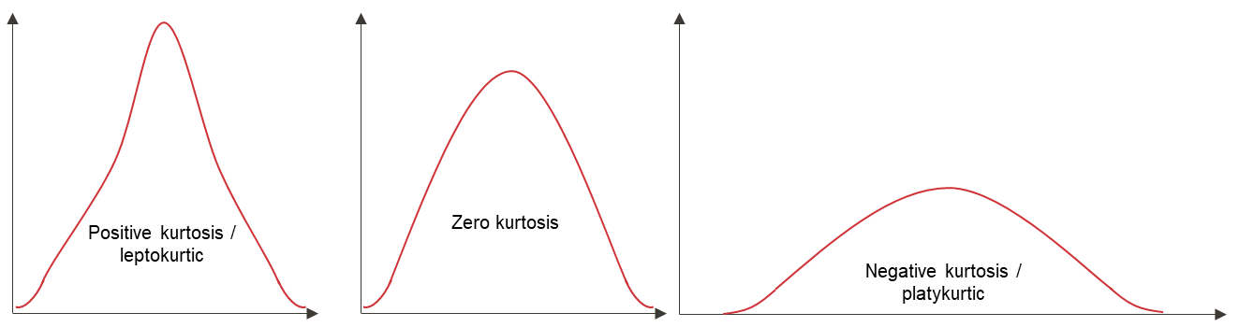
Summarizing a variable: descriptive statistics
Distribution: How is the data distributed?
Kurtosis: How jagged is the data?

Slide 21
Summarizing a variable: visualization
Histogram
What does the data’s distribution “looks like?”
How many data points lie with each bin?

Slide 22
2. FOUNDATIONS OF INFERENTIAL STATISTICS

Slide 23

STATROULETTE
A roulette wheel returns values between 0 and 36.
Let’s simulate a game of roulette in Excel

Slide 24
2. FOUNDATIONS OF INFERENTIAL STATISTICS

Slide 25
DRILL
Simulate 500 rounds of a roulette toss using RANDBETWEEN(0,36)
Plot the resulting frequency distribution
Hit F9 while in your workbook. What happens?

Slide 26
3. T-TESTS FOR BUSINESS IMPACT

Slide 27
DRILL
File:

Slide 28
Frequencies
CASE
WHEN condition THEN result-expression
WHEN condition THEN result-expression ...
ELSE result-expression
END AS alias

Slide 29
Learning SQL, 2nd Edition
by Alan Beaulieu
Human Centered Design • MDLS 2020

Slide 30

MEET YOUR LIBRARIAN, SQL
STRUCTURED
QUERY
LANGUAGE

Slide 31
Common table expressions (CTEs):
Expressions acting like tables
WITH
expression_name_1 AS
(CTE query definition 1)
SELECT expression_A, expression_B, ...
FROM expression_name_1

Slide 32

Learning SQL, 2nd Edition
by Alan Beaulieu
•ON O’REILLY LEARNING AT HTTPS://WWW.OREILLY.COM/LIBRARY/VIEW/LEARNING-SQL-2ND/9780596801847/
Human Centered Design • MDLS 2020

Slide 33
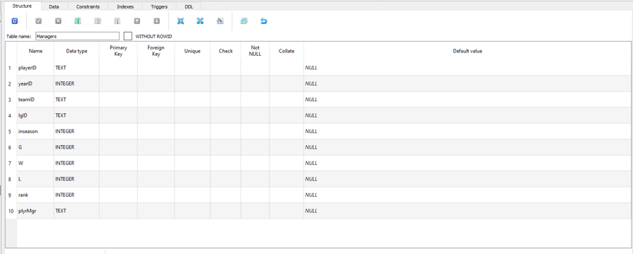
HOW MANY COLUMNS ARE IN MANAGERS?

Slide 34
6. VLOOKUP(), MEET JOIN

Slide 35
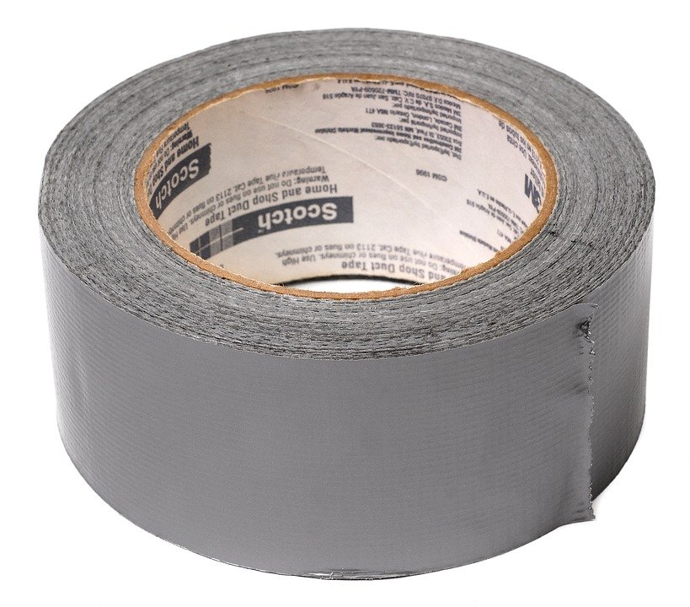

DUCT TAPE, MEET WELDER
VLOOKUP()
JOIN

Slide 36
INNER JOIN:
Returns records that have matching values in Tables A and B
https://github.com/gadenbuie/tidyexplain#mutating-joins
Notes:
These are R functions but the idea is the same.

Slide 37
LEFT OUTER JOIN:
Returns ALL records from Table A and matching records from Table B. Results with no match are null.
https://github.com/gadenbuie/tidyexplain#mutating-joins

Slide 38
7. CONCLUSION

Slide 39
What to learn next?
M language
PowerPivot
Power BI

Slide 40
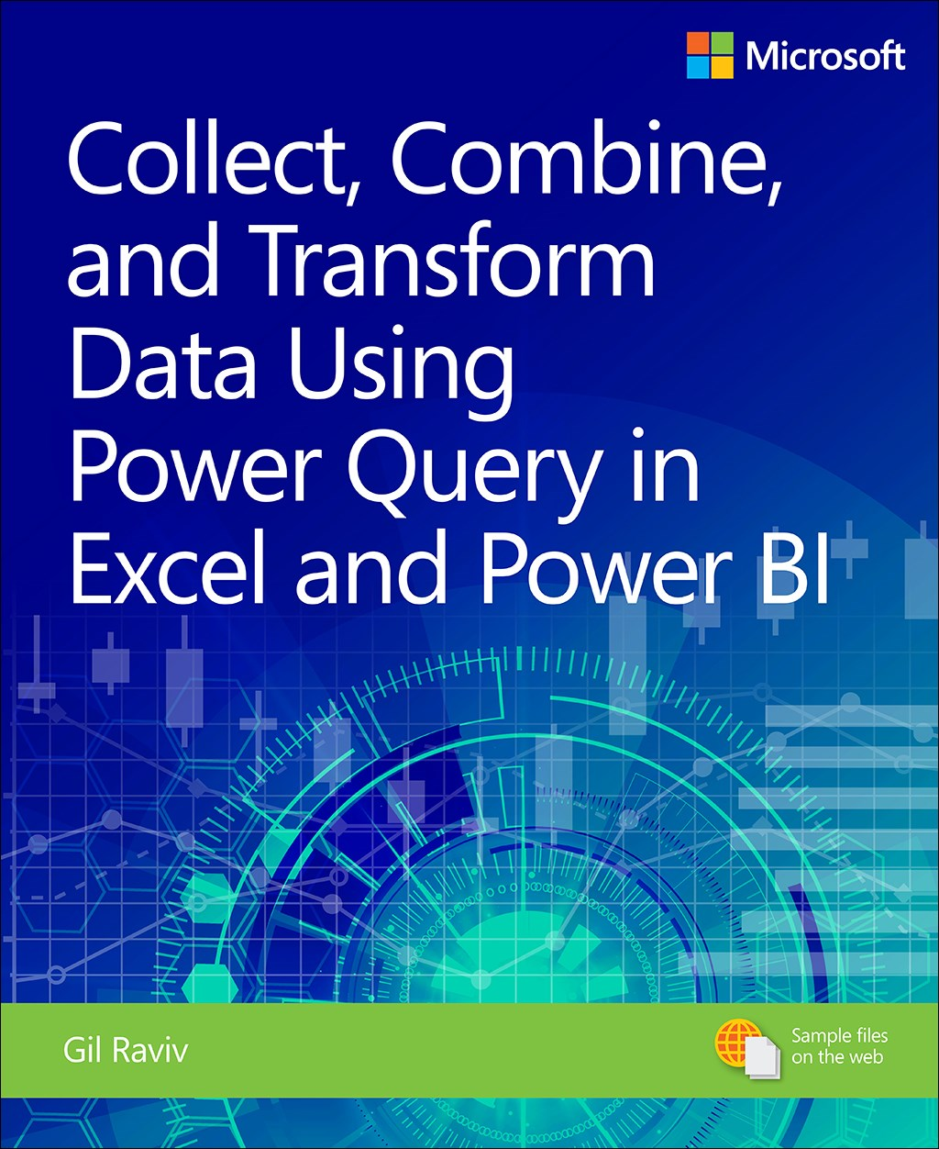
Collect, Combine, and Transform Data Using Power Query in Excel and Power BI, 1st Edition
by Gil Raviv
On O’Reilly Learning at https://learning.oreilly.com/library/view/collect-combine-and/9781509307982/
Human Centered Design • MDLS 2020

Slide 41
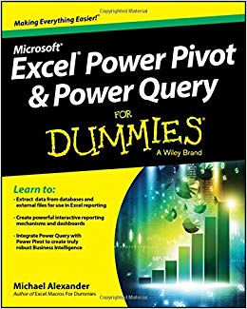
Excel Power Pivot and Power Query For Dummies,
by Mike Alexander
On O’Reilly Learning at https://learning.oreilly.com/library/view/excel-power-pivot/9781119210641/
Human Centered Design • MDLS 2020

Slide 42
LET'S TALK
LINKEDIN
linkedin.com/in/gjmount
PHONE NUMBER
440-879-8399
EMAIL ADDRESS
george@stringfestanalytics.com
WEBSITE
stringfestanalytics.com

